Slide 1
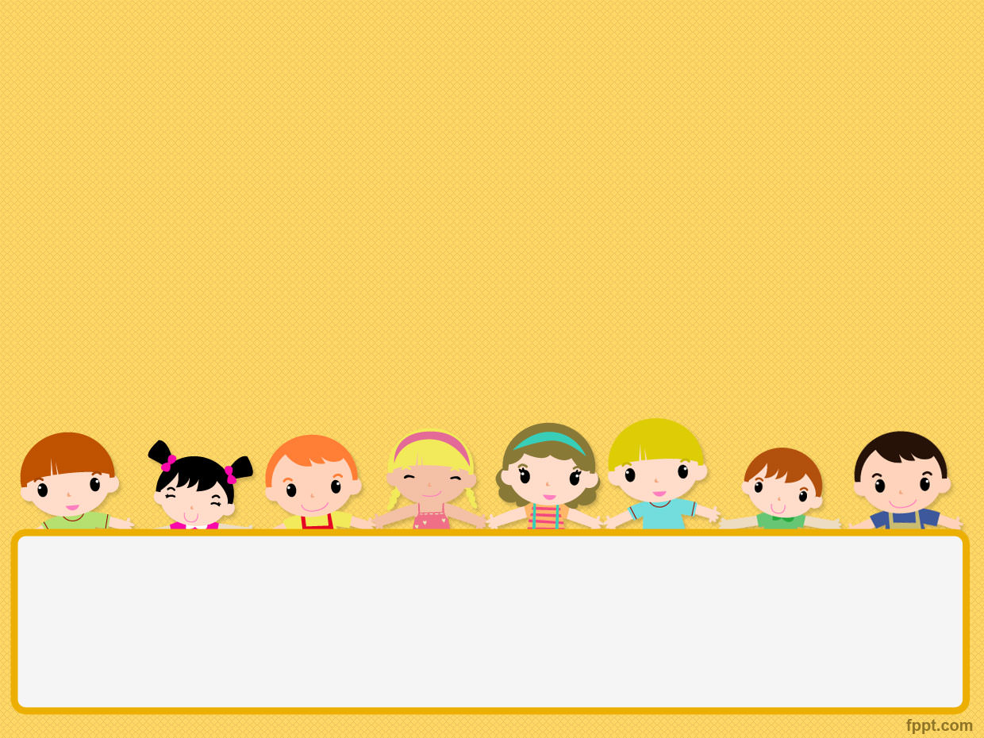
Welcome to class 4A
Unit 2 - I'm from Japan.
Lesson 1

Slide 2
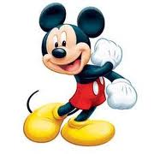
LET’S GAME

Slide 3
Good moning
Good afternoon
Good night
2

Slide 4
afternoon
morning
night
3

Slide 5
afternoon
morning
night
4

Slide 6
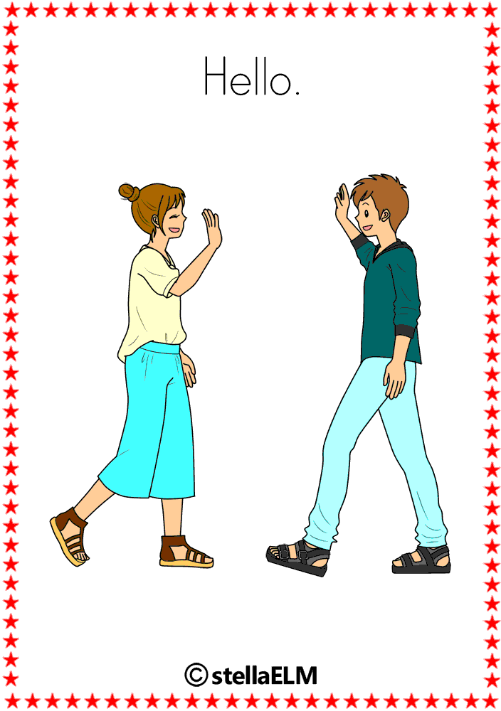
hello
Good bye
bye
5

Slide 7
BYE
GOOD BYE
NICE TO MEET YOU
6

Slide 8
BYE
GOOD BYE
HELLO/ HI
9

Slide 9
New words
America :
Nước Mỹ

Slide 10
New words
England :
Nước Anh

Slide 11
New words
Australia :
Nước Úc

Slide 12
New words
Japan :
Nước Nhật

Slide 13
New words
Malaysia :
Nước Ma-lai-xi-a

Slide 14
New words
Vietnam

Slide 15
New words
Where: đâu, ở đâu
From: từ
Malaysia: Ma-lai-xi-a
America: Mỹ
Australia: Úc
England: Anh
Japan: Nhật Bản

Slide 17
Patterns:
Where are you from?
→I’m from Japan.

Slide 18
Nam
Nam
Akiko
Japan

Slide 19
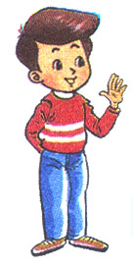
Hello, I’m _TÊN__.
Where are you from?
a
Hi._____.I'm______.
I'm from_________.
Hakim
Hakim/Malaysia
Malaysia

Slide 20
Hello, I’m _TÊN__.
Where are you from?
b
Tom/America
Hi,_____. I'm ____.
I'm from ________.
Tom
America

Slide 21
Hello, I’m _TÊN__.
Where are you from?
c
Hi,____. I'm_____.
I'm from_________.
Tony
Tony/Australia
Australia

Slide 22
Hello, I’m _TÊN__.
Where are you from?
d
Hi,____. I'm _____.
I'm from ________.
Linda
Linda/England
England

Slide 24
Australia
America
Malaysia
Japan

Slide 26
“Guess the picture”
game

Slide 27
Where are you from?
1
2
3
4
I’m from __________
England

Slide 28
Where are you from?
1
2
3
4
Australia
I’m from _________

Slide 29
Where are you from?
1
2
3
4
Malaysia
I’m from __________

Slide 30
Where are you from?
1
2
3
4
I’m from __________
Viet Nam

Slide 31
Where are you from?
1
2
3
4
Japan
I’m from __________

Slide 32
Good bye!
See you later!

